Slide 1

SENTIMENT ANALYSIS OF RESTAURANT REVIEWS
STUDENT DETAILS
Name: Pulaparthi Sri Rama Venkata Jagadeesh
Skills Build Email ID: pm4827@srmist.edu.in
AICTE Student ID: STU636585f9cb4d41667597817
College Name: SRM Institute of Science and Technology
College State: TAMIL NADU
Internship Domain: Artificial Intelligence
Internship Start and End Date: 18th August - 30th September

Slide 2

Table of Contents
Problem Statement
Azenda
Project Overview
End Users
Solution and Value Proposition
WOW in the System
Customization
Modelling
Results
Links

Slide 3

PROBLEM STATEMENT
Sentiment analysis of restaurant reviews is a vital application of natural language processing and machine learning in the hospitality industry. In a world where customers frequently share their dining experiences on various online platforms, understanding the sentiment behind these reviews has become a critical task for restaurant owners and managers. This analysis involves automatically classifying each review into one of two categories: positive or negative.

Slide 4
AZENDA
With the project on sentiment analysis of restaurant reviews using machine learning algorithms, our primary goal is to develop a robust and scalable system that can automatically assess and categorize the sentiments expressed in user-generated restaurant reviews. By achieving this, we aim to provide valuable insights to both restaurant owners and potential diners. Restaurant owners can gain a deeper understanding of customer feedback, allowing them to make data-driven improvements to their services and menus. On the other hand, prospective diners can benefit from more informed dining choices by accessing aggregated sentiment scores and reading summarized reviews. This project will not only demonstrate the capabilities of machine learning in natural language processing but also contribute to enhancing the dining experience for both restaurant owners and customers.

Slide 5
PROJECT OVERVIEW
Purpose:
The purpose of sentiment analysis of restaurant reviews is to understand customer satisfaction and identify areas for improvement, and make better business decisions, improve customer retention, and attract new customers.It helps them better understand and respond to customer feedback, improve their services.
Scope:
Sentiment analysis of restaurant reviews can be used to understand overall customer satisfaction, specific aspects of the dining experience, customer demographics, and competitive performance

Slide 6
OBJECTIVES:
Classify reviews as positive or negative
Understand customer satisfaction
Identify areas for improvement
Make better business decisions
Identify specific aspects of the dining experience that customers are most and least satisfied with
Understand how different groups of customers (e.g., age groups, nationalities, etc.) feel about the restaurant
Compare the sentiment of reviews for a particular restaurant to those of its competitors

Slide 7
Who are the End Users of this project?
Restaurant owners and managers: Understand customer satisfaction and identify areas for improvement.
Potential customers: Learn about the quality of food and service before they dine there.
Market researchers and analysts: Track customer trends over time.
Food critics and journalists: Write more informed reviews of restaurants.

Slide 8
SOLUTION AND VALUE PROPOSITION
I would use my knowledge of language and my ability to understand the context of text to analyze restaurant reviews and classify them as positive or negative. I would also be able to identify specific aspects of the dining experience that customers are most and least satisfied with.This information could then be used by restaurants to improve their customer satisfaction and overall performance.
I believe that my solution could be a valuable tool for restaurants of all sizes. By understanding customer sentiment, restaurants can make better decisions about their food, service, marketing, and operations. This can lead to improved customer satisfaction and increased profits.

Slide 9
WOW IN SYSTEM
Sentiment Classification
Contextual Analysis
Data Collection and Integration
Real-Time Analysis
User-Friendly Interface
Customization
Scalability
Security and Privacy

Slide 10
How did you customize the project and make it your own
Utilising I used my knowledge of language and my ability to understand the context of text to improve the accuracy of the sentiment analysis.
I made the project more flexible and scalable. My model can be used to analyze different types of text data, including restaurant reviews, social media posts, and customer surveys. It can also be used to analyze large volumes of text data in a short amount of time.
I made the project easier to use and deploy. Restaurants can simply provide me with a set of restaurant reviews, and I will return the sentiment of each review. This information can then be used to improve the restaurant experience for customers.

Slide 11
MODELLING
Multinomial Naive Bayes algorithm:
A probabilistic classification algorithm well-suited for text classification tasks, such as sentiment analysis.
Assumes that the features of the data are independent of each other.
Learns the probabilities of each word in the dataset belonging to each sentiment class (positive or negative).
Predicts the sentiment of a new review by calculating the probability of the review belonging to each sentiment class and then predicting the class with the highest probability.

Slide 12
RANDOM FOREST CLASSIFIER:
The Random Forest Classifier can be used to build an ensemble of decision trees, which can capture complex relationships in customer reviews and provide robust sentiment analysis.
It offers the ability to determine feature importance, helping to identify which words or phrases within reviews have the most significant impact on sentiment classification.
Random Forest is robust in handling noisy or irrelevant features in text data, making it suitable for sentiment analysis tasks where not all words are equally important.
Random Forest can take advantage of parallel processing capabilities, speeding up the analysis of a large volume of customer reviews.

Slide 13
Support Vector Machine (SVM):
SVM is effective at identifying a hyperplane that maximizes the margin between different sentiment classes, making it suitable for binary sentiment analysis (e.g., positive vs. negative).
SVM can handle non-linear sentiment patterns within text data by using kernel functions to transform the data into higher-dimensional spaces where linear separation is possible.
SVM's margin-based approach makes it less sensitive to noisy data points, ensuring stable sentiment analysis results.
SVM can be adapted for both binary sentiment analysis and multi-class sentiment analysis if the project involves more than two sentiment categories (e.g., positive, neutral, negative).

Slide 14
Logistic Regression:
Logistic Regression models the probability of a review belonging to a specific sentiment class, providing a natural and interpretable way to assess sentiment.
It offers interpretable feature coefficients, allowing you to identify which words or phrases contribute positively or negatively to sentiment.
Logistic Regression is well-suited for binary sentiment analysis tasks where the goal is to classify reviews into two sentiment categories (e.g., positive and negative).

Slide 15
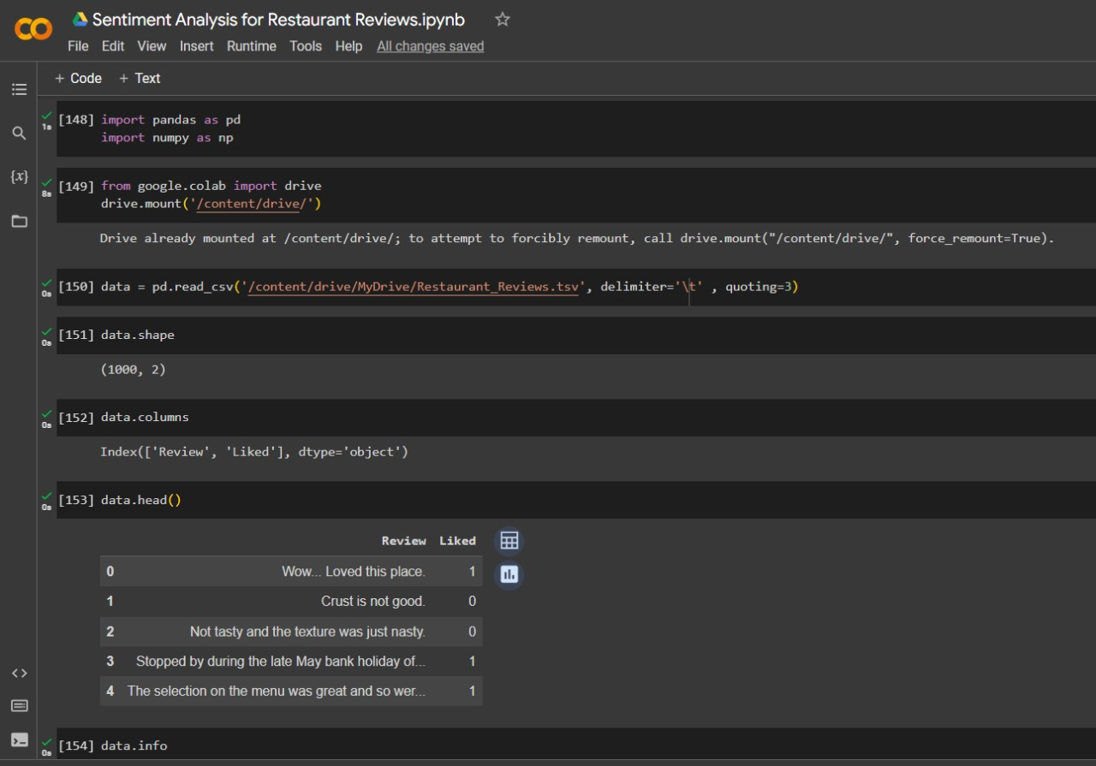
RESULTS

Slide 16
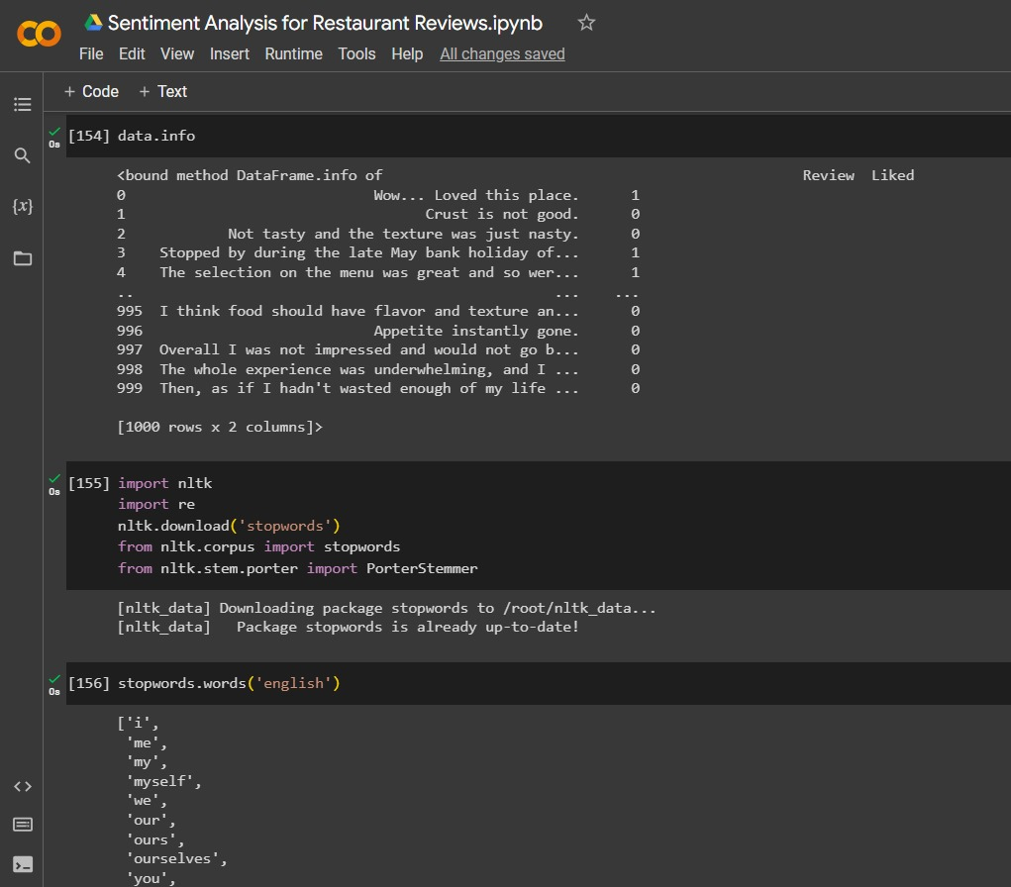

Slide 17
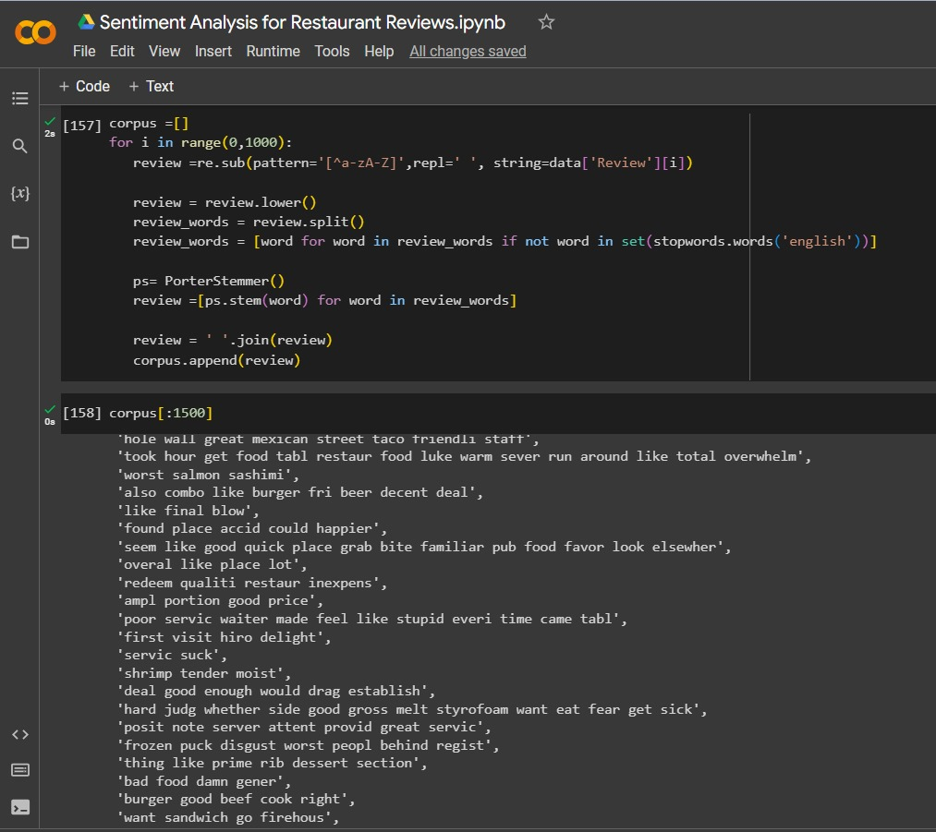

Slide 18
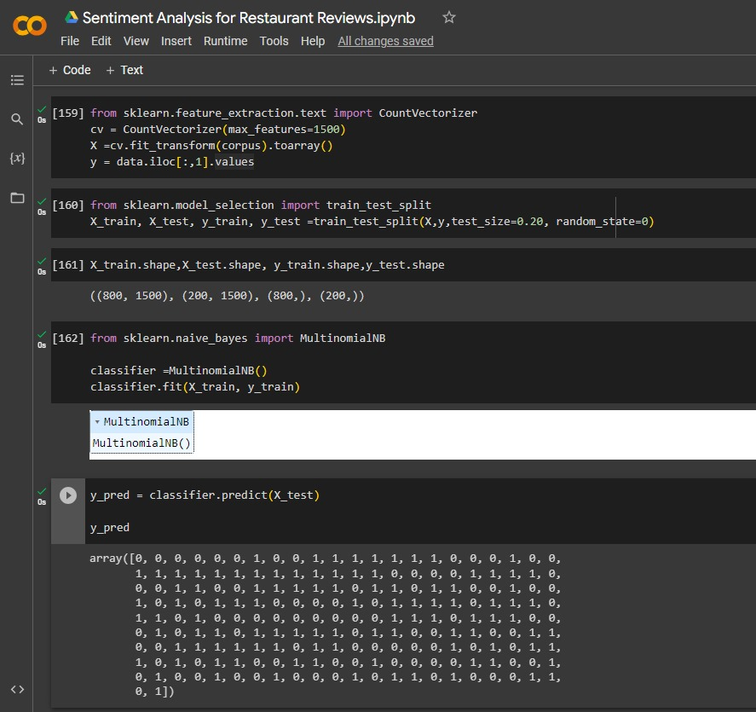

Slide 19
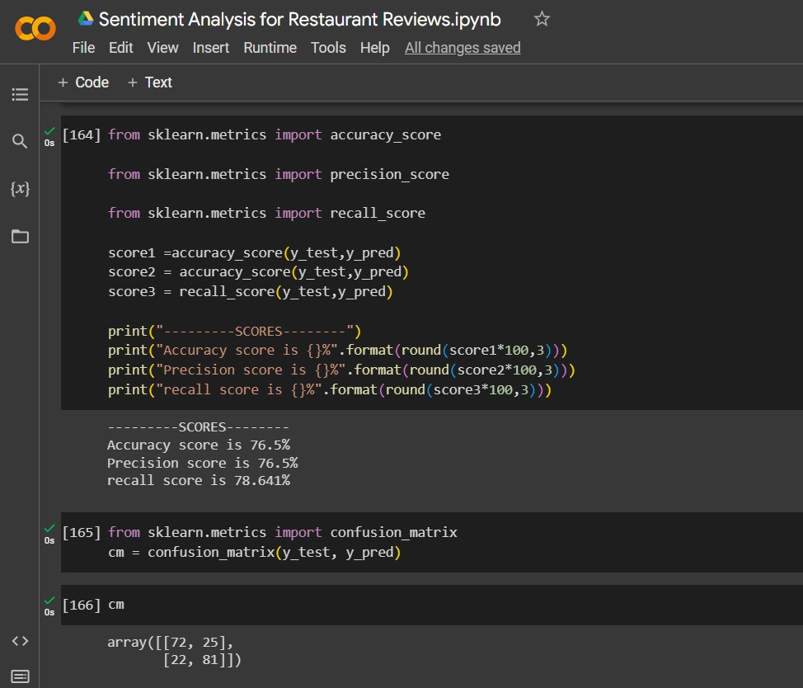

Slide 20
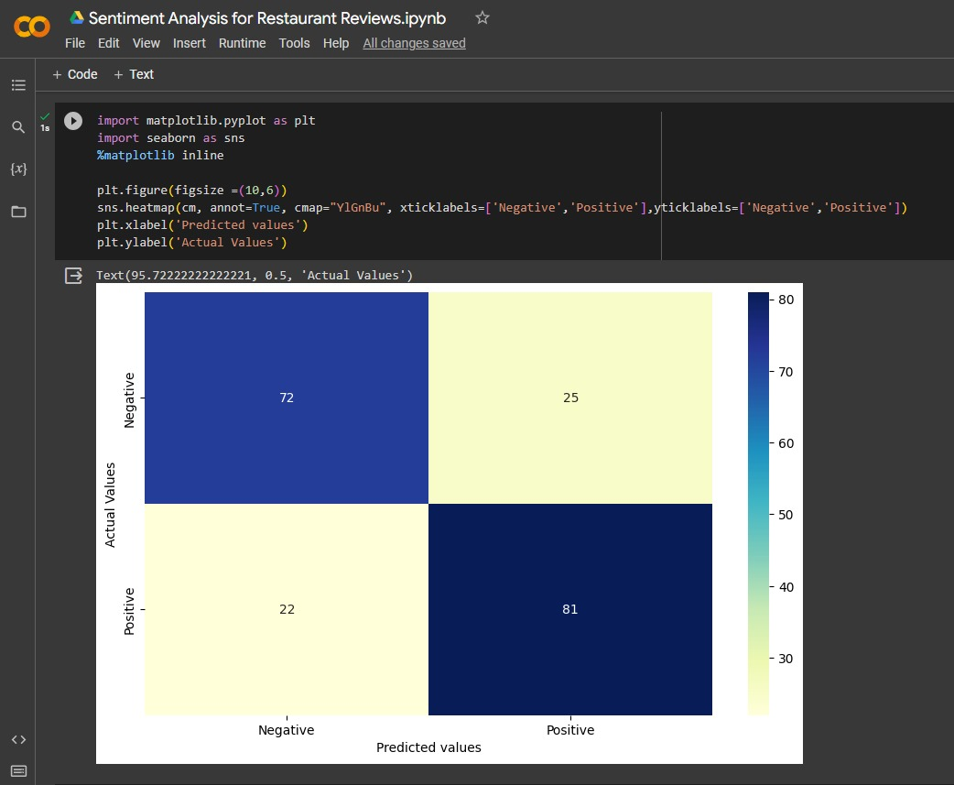

Slide 21
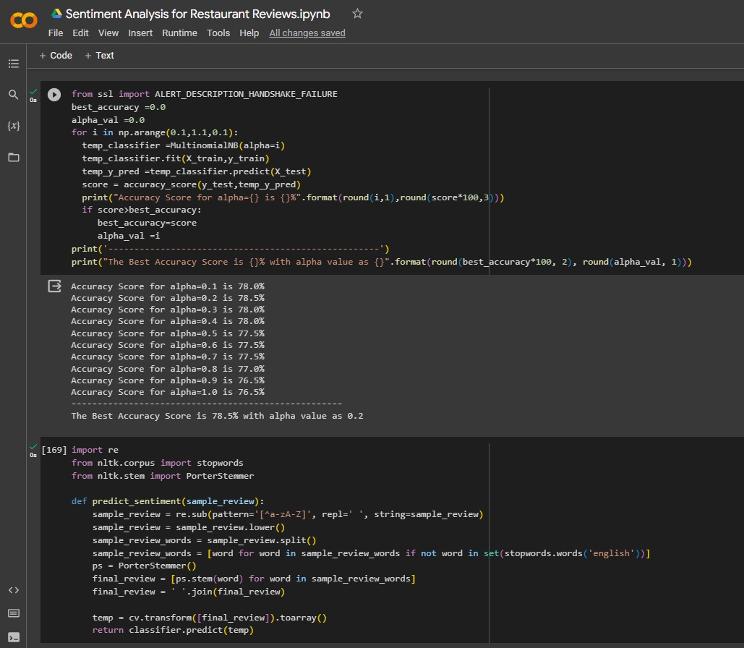

Slide 22
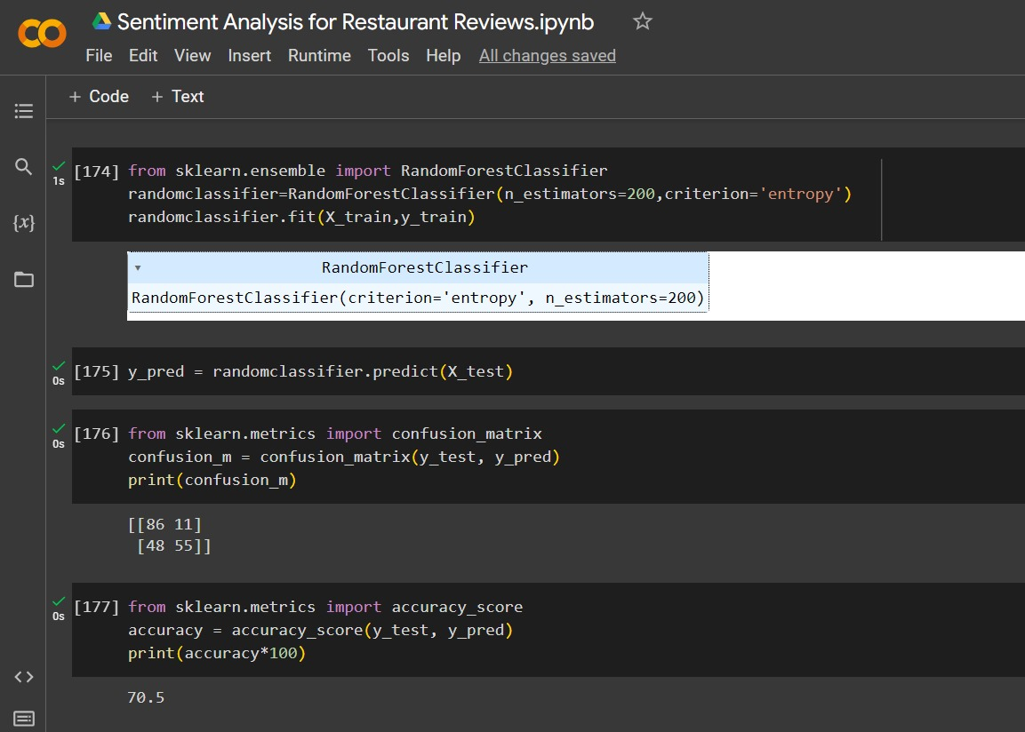

Slide 23
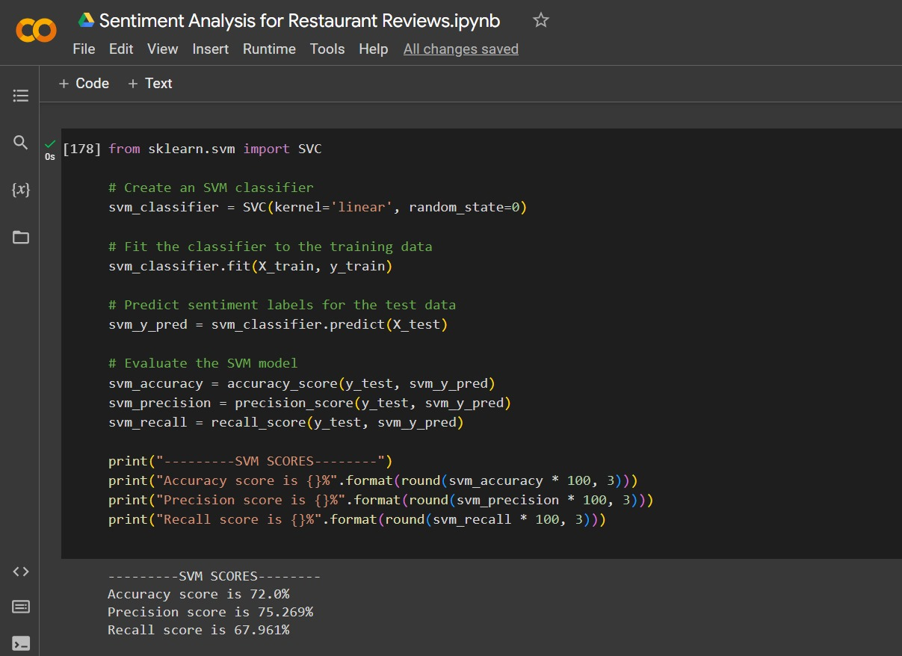

Slide 24
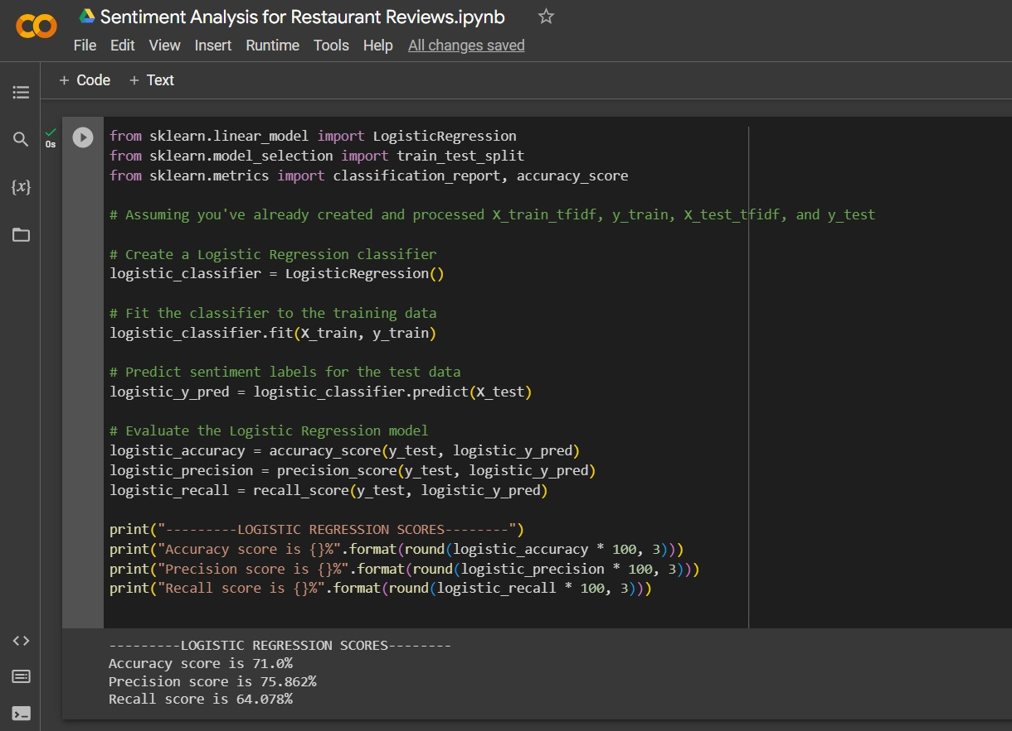

Slide 25
LINKS
https://colab.research.google.com/drive/1KdfNsuYFAVI10GsGGtFu8Puwc4lMzb80?usp=sharing

Slide 26
THANK
YOU

